Slide 1

Next Word Predictor
DRTS Group Inc

Slide 2

PROJECT OVERVIEW
Objective:
Build an AI-powered application to predict the next word in a sequence, enhancing user typing efficiency and experience.
Demonstrate technical expertise in AI modelling, cloud hosting, and end-to-end development to deliver a deployable predictive text solution.
Scope (Technical Features):
Focus on predictive text generation using both statistical and advanced AI models.
Deliver a cloud-hosted, scalable application with user-friendly interaction and real-world applicability.
Impact:
Business Impact: Improve user productivity and typing speed with accurate word predictions.
Educational Impact: Showcase end-to-end AI application development skills using modern technologies like N-grams, RNNs, and BERT.

Slide 3
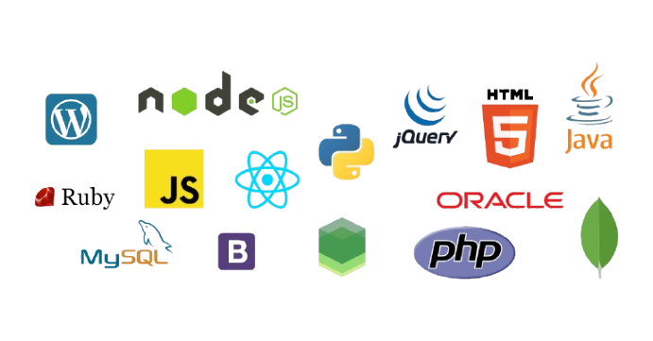
PLAN & TECHNOLOGY FRAMEWORK
Phases:
Discovery & Planning: Define project scope, analyze requirements, and prepare datasets.
Development: Build a pipeline for text tokenization, frequency analysis, N-gram modelling, and integrate deep learning models.
Testing & Deployment: Validate prediction accuracy, ensure usability, and deploy the solution to the cloud.
Key Deliverables:
Prototype within 4 weeks.
Fully functional and cloud-deployed project by [final deadline].
Technology Landscape:
AI Frameworks: TensorFlow, PyTorch, or Scikit-learn.
Data Engineering: Pandas, SQL, NLTK, or SpaCy.
Cloud Platforms: AWS, Azure, or Google Cloud.
Integration Tools: FastAPI for the backend and a web-based UI for the frontend

Slide 4
APPLICATION FLOW
User type in a text box
Backend processes tokens & predicts next word
Predicted words displayed in a drop down
Input Stage:
User inputs text through the interface.
Data sent via an API call to the backend.
Processing Stage:
Text is tokenized and analyzed using word frequency/N-gram models.
Advanced models (RNN, LSTM, or BERT) refine predictions for better context understanding.
Output Stage:
Predictions are displayed dynamically in the interface for real-time interaction.

